Slide 1
HOW TO SPEND A SAFE HOLIDAY?

Slide 2
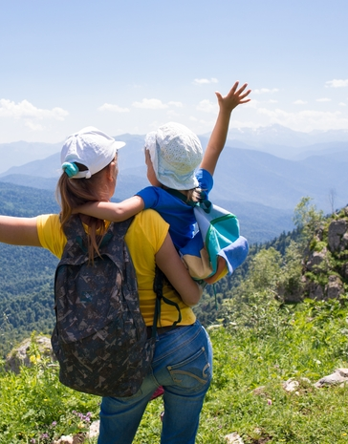
SAFETY IN THE MOUNTAINS
Before going to the mountains, prepare the appropriate clothes. In the mountains, you must not leave the trail, because you can enter dangerous areas.

Slide 3
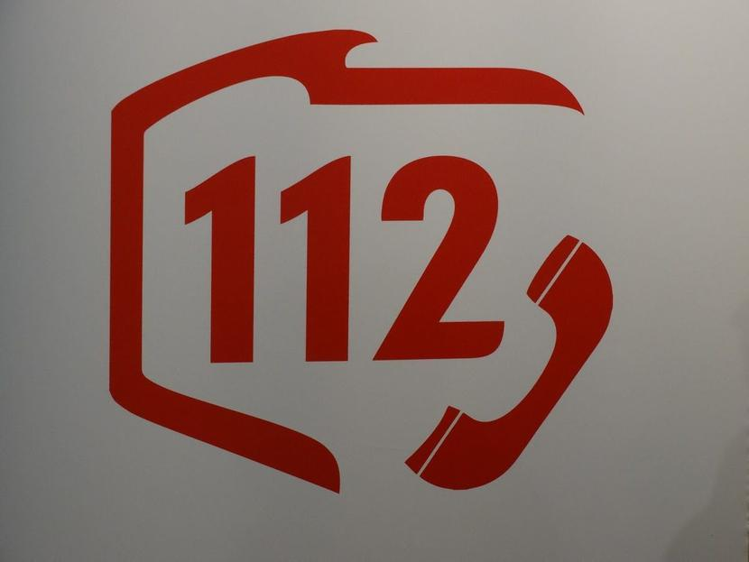
WHAT TO DO IN CASE OF EMERGENCY?
If you find yourself in a dangerous situation, immediately report for help to the appropriate services. The main number to keep in mind is the pan-European emergency number 112.

Slide 4
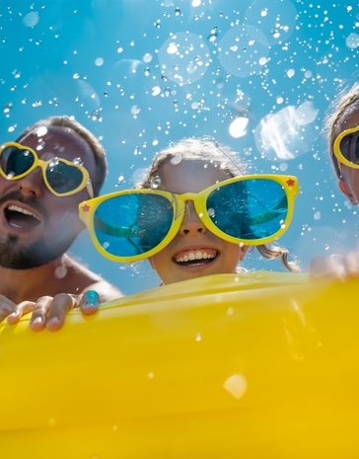
SAFETY ON THE WATER
The first, basic rule of safety on the water is not to drink alcohol. Liquors combined with high temperatures become a bad advisor. Being under the influence of alcoholic beverages, a person is unable to rationally assess the situation and their abilities. The second rule is to bathe only in designated places: at guarded and safe bathing areas.

Slide 5
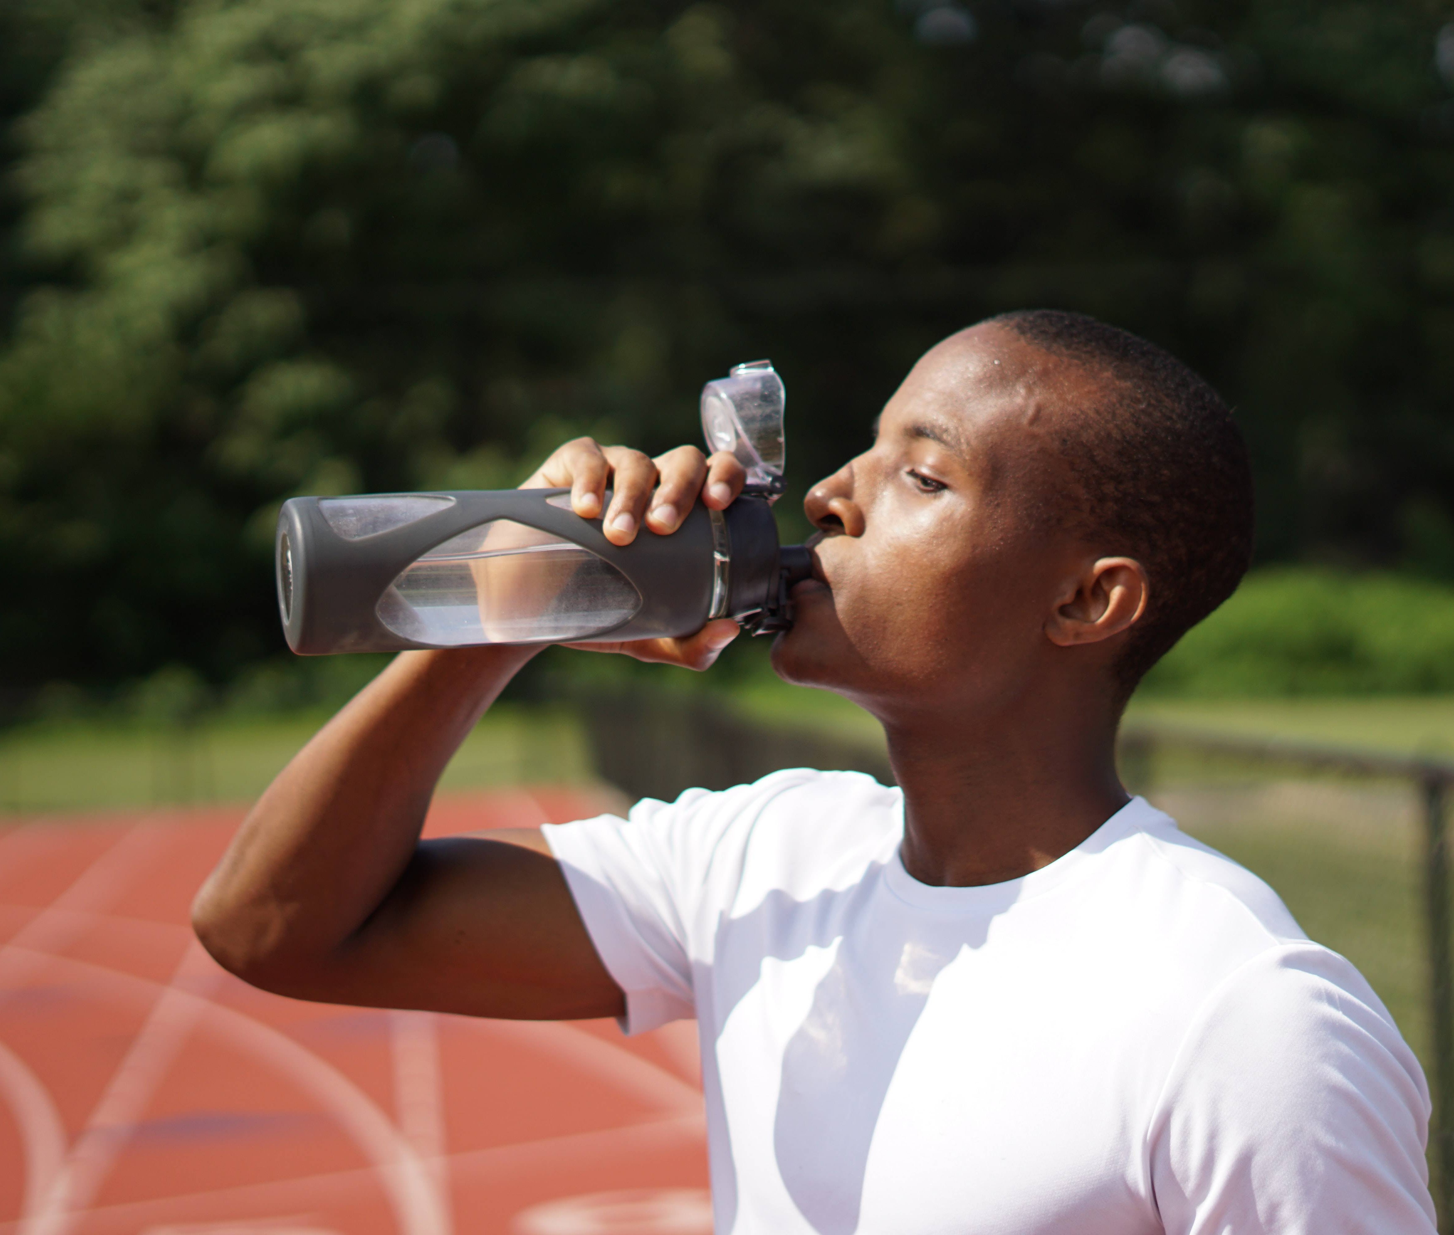
HYDRATE!
An adult should drink 1.5 to 2 liters of fluids during the day, and up to 3.5 liters in hot weather. On trips or the beach, it is mandatory to take mineral water with you to avoid dehydration.

Slide 6
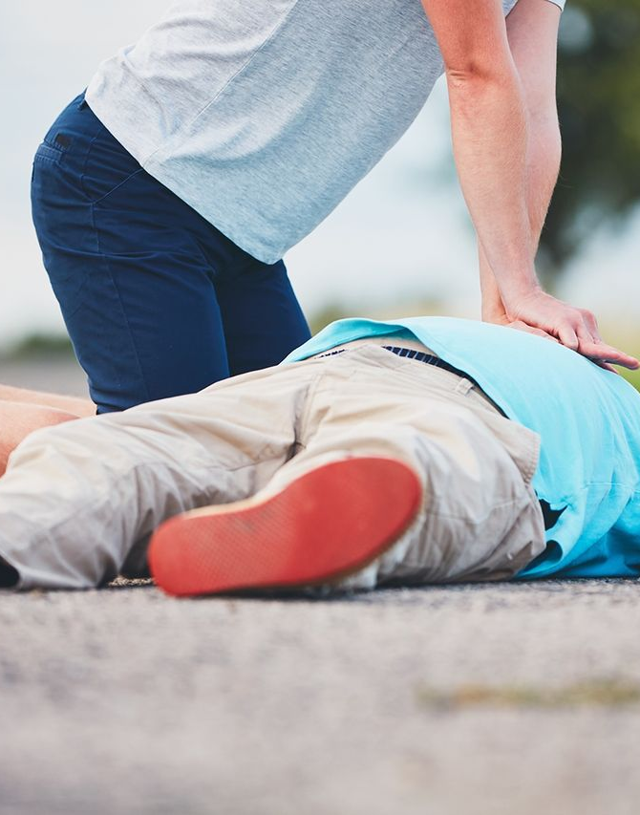
LEARN THE BASICS OF SAVING A LIFE OR REMEMBER THEM
A quick and correct response can save someone's life. It is worth knowing how and when to put the body in a safe position, what to do in case of fainting, bleeding, etc.

Slide 7
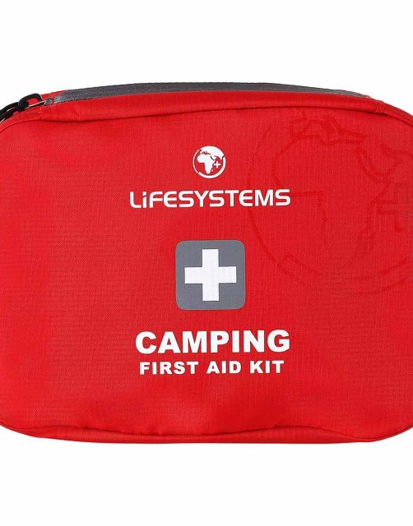
TAKE A FIRST AID KIT ON A TRIP
Be sure to stock up on supplies and first aid kit. They will come in handy in the event of an emergency illness or injury that may occur while travelling. If you are taking medications on a regular basis, do not forget to take them with you.

Slide 8
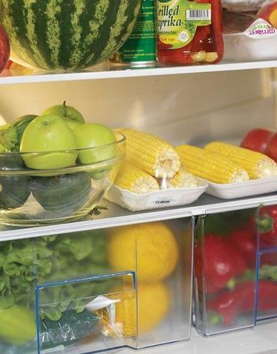
PAY ATTENTION TO WHAT YOU EAT
In summer, food spoils easily – due to higher temperatures, poor storage or eating in random places. Eating spoiled food most often leads to poisoning. Therefore, store food products in the right conditions and low temperature, wash fruits and vegetables before eating, observe the expiry dates of products.

Slide 9
BEFORE YOU LEAVE, READ THE INFORMATION ABOUT THE PLACE WHERE YOU ARE GOING
Remember to read about the risks in the place you are going to.

Slide 10
THANK YOU FOR YOUR ATTENTION

